Slide 1
Ensemble Learning
Bagging, Boosting & Stacking
Notes:
Welcome. Today: what ensemble learning is, why it works, and the two big families - bagging and boosting - plus a quick look at stacking. Hook idea: jellybean jar guessing game.

Slide 2
Learning Objectives
Understand what ensemble learning is and why we combine models
1
Learn the three techniques: Bagging, Boosting, Stacking
2
Compare how Bagging and Boosting work and where to use them
3
Notes:
Read the three objectives aloud. Tell students they will be able to explain these in their own words by the end of the session.

Slide 3
What is Ensemble Learning?
Combine many models into one stronger model
Each model has different strengths and makes different mistakes
Result: fewer errors, higher accuracy, more robust predictions
Model 1
Ensemble
Model 2
Model 3
Think: ask 10 doctors instead of 1
Notes:
Jellybean analogy: the average of many guesses is usually closer than most individual guesses. That is the whole idea of an ensemble.

Slide 4
Why Do We Need Ensembles?
Bias
Variance
Noise
Model too simple, misses patterns (underfitting)
Model too sensitive to training data (overfitting)
Random error in data that nobody can remove
Bagging
reduces variance
Boosting
reduces bias
Notes:
Every model's error = bias + variance + noise. Bias = too simple. Variance = too sensitive to the training data. Ensembles attack bias and variance. Noise cannot be removed by anyone.

Slide 5
Ensemble Techniques
Ensemble Methods
Bagging
Boosting
Stacking
Random Forest
AdaBoost
Gradient Boosting
XGBoost
Meta-model combines different models
Notes:
Three families. Bagging: parallel, e.g. Random Forest. Boosting: sequential, e.g. AdaBoost, Gradient Boosting, XGBoost. Stacking: a meta-model learns to combine models.

Slide 6
What is Bagging?
Bagging = Bootstrap Aggregating
1
2
3
Data Sampling
Model Training
Aggregation
Make many random subsets (with replacement)
Train a separate model on each subset
Average (regression) or majority vote (classification)
Goal: better accuracy and more stable predictions
Notes:
Bagging = Bootstrap Aggregating. Three steps: sample, train, aggregate. Emphasise that models are trained independently, so they can run in parallel.

Slide 7
The Process of Bagging
Bootstrap samples
Train
Predict
Combine
Subset 1
Model
prediction
Training set
Model
Aggregation
Subset 2
prediction
Subset m
Model
prediction
Notes:
Walk left to right: one training set becomes m bootstrap subsets; each trains its own weak learner; predictions are combined by the aggregator. n (subset size) is ideally the same as N.

Slide 8
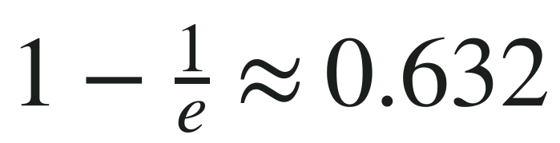
Bootstrap Sampling
63%
Same size as the original data
With replacement: some rows appear several times
Some rows are left out (about 37%): called out-of-bag
Why it matters: each model sees slightly different data
of the original data appears in each bootstrap sample
Notes:
Classroom question: what fraction of the data appears in each bootstrap sample? About 63.2% (1 - 1/e). The ~37% left out is called out-of-bag and gives a free validation estimate.

Slide 9
Bagging Algorithm
k = number of bootstrap samples
for i = 1 to k:
Di = bootstrap sample (size N)
Ci = train classifier on Di
Final: majority vote of C1 ... Ck
Sample
Train
Vote
Notes:
This is the textbook bagging algorithm. Stress that any base classifier can be plugged in, but unstable ones (like deep trees) gain the most.

Slide 10
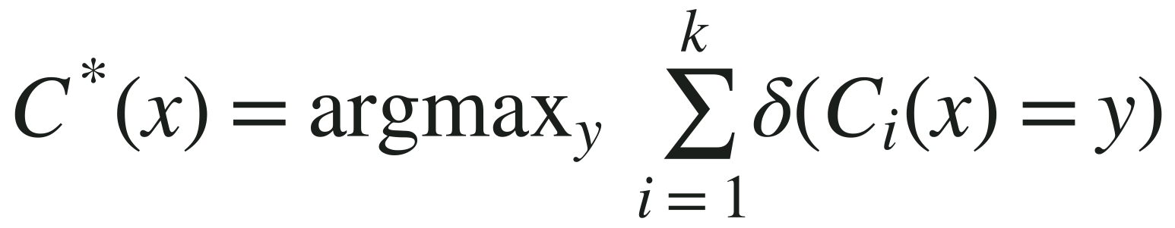
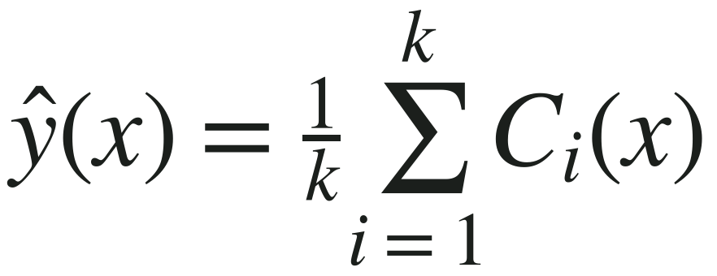
Bagging Formulas
Classification: each of the k models votes
δ(·) = 1 if model i predicts class y, else 0
argmax picks the class with the most votes
Regression: average the k predictions
ŷ = final predicted value
C_i(x) = prediction of model i
Notes:
Aggregation. For classification each of the k models casts one vote; delta is an indicator that is 1 when the model predicts class y and 0 otherwise; argmax picks the class with the most votes. For regression we simply average the k predictions.

Slide 11
When Does Bagging Help?
Unstable models
Stable models
e.g. deep decision trees
e.g. linear models
Big improvement
Averaging cancels random errors
Little or no gain
Each sample has ~37% less unique data, so it can even hurt
Bonus: less overfitting on noisy data, since every sample is equally likely
Notes:
Unstable = small change in data gives a very different model (deep trees). Stable = robust to small changes (linear models). Bagging mainly cuts variance, so it shines on unstable learners.

Slide 12
Random Forest
Bagging + random feature selection
An ensemble built from many decision trees
Each tree uses its own random sample and random features
Final answer = vote of all trees
Notes:
Random Forest = bagging of decision trees + random feature selection at each split. The feature randomness makes the trees less correlated, so averaging works better.

Slide 13
Random Forest in 4 Steps
Create a bootstrapped dataset
Build a tree using a random subset of columns at each step
1
2
Repeat steps 1 and 2 to build many trees
Classify new data by majority vote
3
4
Notes:
Give the big picture first. The next four slides walk through each step with a heart disease example.

Slide 14
Step 1: Create a Bootstrapped Dataset
Original dataset
Bootstrapped dataset
Chest Pain | Good Blood Circ. | Blocked Arteries | Weight | Heart Disease
No | No | No | 125 | No
Yes | Yes | Yes | 180 | Yes
Yes | Yes | No | 210 | No
Yes | No | Yes | 167 | Yes
Chest Pain | Good Blood Circ. | Blocked Arteries | Weight | Heart Disease
Yes | Yes | Yes | 180 | Yes
No | No | No | 125 | No
Yes | No | Yes | 167 | Yes
Yes | No | Yes | 167 | Yes
Rows are picked with replacement: one row can appear twice
Notes:
Pick rows at random WITH replacement until the new dataset is the same size as the original. Note the last two rows are identical: one row was picked twice and one row (Yes, Yes, No, 210) was left out.

Slide 15
Step 2: Pick Random Columns
Bootstrapped dataset
Use only 2 of the 4 variables
Picked at random: Good Blood Circ. and Blocked Arteries
Best of the two becomes the root node
Chest Pain | Good Blood Circ. | Blocked Arteries | Weight | Heart Disease
Yes | Yes | Yes | 180 | Yes
No | No | No | 125 | No
Yes | No | Yes | 167 | Yes
Yes | No | Yes | 167 | Yes
Not all columns are considered at each split
Notes:
At each split we only consider a random subset of the columns - here 2 of the 4 predictors. This is the extra randomness that distinguishes Random Forest from plain bagging.

Slide 16
Step 2 (cont.): Every Split Re-Picks
Good Circ.
Root used Good Circ.
3 columns remain
Pick 2 at random as candidates for the next node
Repeat until the tree is built
?
Next split: choose from Chest Pain or Weight
Notes:
Same idea at every node: after the root uses Good Circ., choose 2 of the 3 remaining columns at random as candidates for the next split.

Slide 17
Step 3: Repeat to Build Many Trees
Variety makes a forest better than a single tree
Notes:
Go back to step 1 and repeat with a fresh bootstrapped dataset. Because both the rows and the columns vary, we get many different trees. That diversity is the whole point.

Slide 18
Step 4: Majority Vote
Tree 1
Yes
New patient
Chest Pain: Yes
Good Circ.: No
Blocked Art.: No
Tree 2
No
YES
3 votes to 2
Tree 3
Yes
Tree 4
Yes
Tree 5
No
Notes:
Pass the new patient through every tree. Each tree votes; the majority wins. Here 3 trees say Yes and 2 say No, so the forest predicts Yes.

Slide 19
What is Boosting?
Iterative: models are built one after another
Focus on hard examples that earlier models got wrong
Weights are given to each training example
Mistakes get higher weight in the next round
Round 1: equal weights
Round 2: mistakes weigh more
Red = misclassified
Notes:
Boosting is sequential: each new learner concentrates on the examples that the earlier learners got wrong. The circles on the right show the weights growing for the mistakes.

Slide 20
How Boosting Uses Weights
Start: every example gets an equal weight of 1/N
Weights can be used in two ways:
Sampling distribution
Biased learning
Draw bootstrap samples according to the weights
The base classifier learns a model biased toward high-weight examples
Notes:
Initial weight is 1/N for every example so each is equally likely to be chosen. After each round weights change. They can be used to resample the data, or the learner can be trained to favour heavy examples.

Slide 21
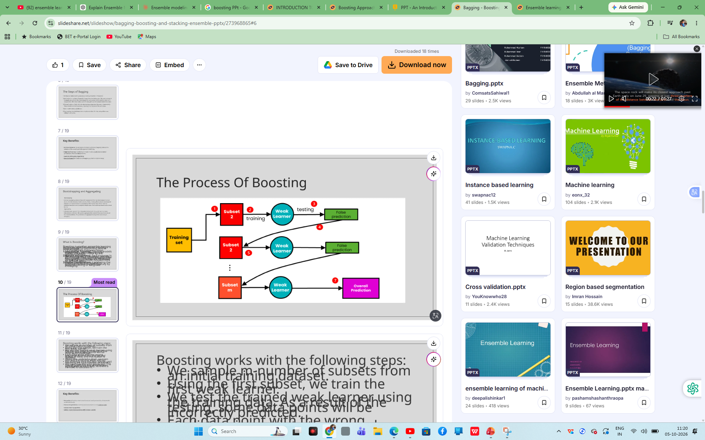

Slide 22
The Process of Boosting
Round 1
Round 2
Round 3
Training data
Model 1
Model 2
Model 3
…
Weighted vote
Mistakes get higher weight
Mistakes get higher weight
Each model learns from the previous model's mistakes
Notes:
Walk left to right. Model 1 trains on the data; its mistakes get higher weight; Model 2 focuses on those; and so on. At the end, all models vote, with better models getting a bigger vote. Contrast with bagging, where models are independent.

Slide 23
How Boosting Works
1
2
3
4
5
Train a weak learner
Find its mistakes
Raise weights of mistakes
Train the next learner
Combine with weighted vote
Repeat for many rounds
Caution: too many rounds on noisy data can overfit
Notes:
This is the AdaBoost-style loop. For gradient boosting, replace 'raise weights of mistakes' with 'fit the next tree to the residual errors'. Warn: too many rounds on noisy data overfits.

Slide 24
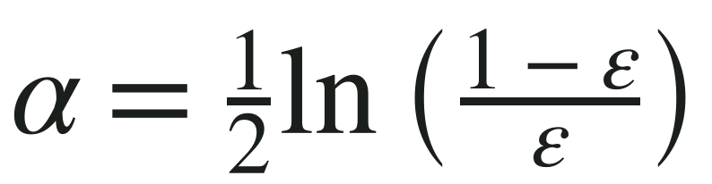
AdaBoost: Adaptive Boosting
Weak learners: usually decision stumps (one split)
Start: every example has equal weight
Each round: mistakes get higher weight
Final answer: weighted vote, accurate learners get a bigger say
Stump
Learner's say
Low error → big say
Notes:
AdaBoost = Adaptive Boosting. Weak learners are usually stumps (one split). Each learner's say alpha = 1/2 ln((1-error)/error): low error means a big say.

Slide 25
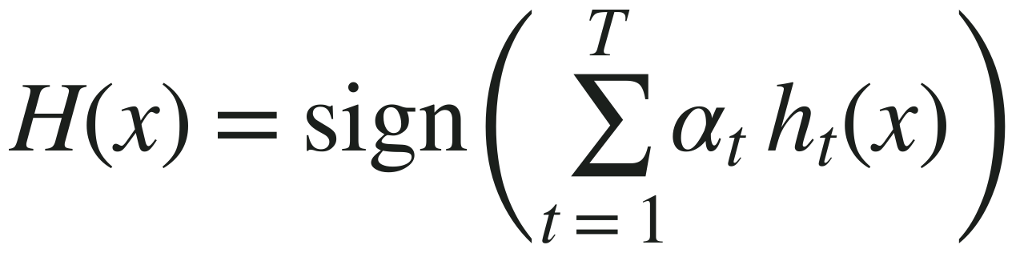
AdaBoost Algorithm
1
Initialize
2
Train
3
Error
Every weight w = 1/N
Fit a weak learner on the weighted data
ε = total weight of the mistakes
4
Learner's say
5
Update weights
6
Repeat, then vote
Mistakes get heavier, correct ones lighter, then normalize
Notes:
Six steps. w = example weights, epsilon = weighted error, alpha = the learner's say. Mistakes are multiplied by e^alpha (bigger), correct ones by e^-alpha (smaller), then all weights are normalised to sum to 1. Final prediction: sign of the weighted sum of learner outputs.

Slide 26
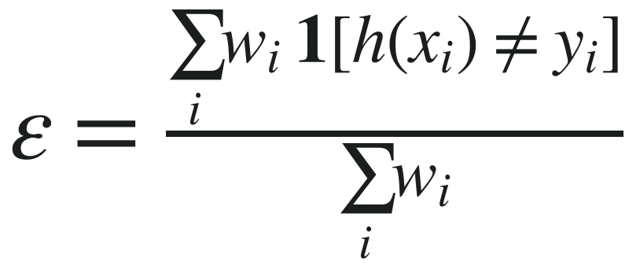
AdaBoost Formulas (1/2): Error and Say
ε (error): share of the total weight the learner got wrong
w_i = weight of example i
1[ ] = 1 for a mistake, 0 if correct
α (say): how much this learner's vote counts
Small error → big α
ε = 0.5 (random guess) → α = 0
ε = 0.1 → α = 1.10
ε = 0.2 → α = 0.69
ε = 0.3 → α = 0.42
ε = 0.5 → α = 0
Notes:
Error: the share of total weight that the learner misclassified (the bracket is 1 for a mistake, 0 otherwise). Say alpha: if error is small alpha is large; error 0.5 is a coin flip so alpha is 0. Quick values: 0.1 gives 1.10, 0.2 gives 0.69, 0.3 gives 0.42, 0.5 gives 0.

Slide 27
AdaBoost: Worked Example
Example | Result | Old weight | New weight
1 | Correct | 0.20 | 0.125
2 | Correct | 0.20 | 0.125
3 | Wrong | 0.20 | 0.500
4 | Correct | 0.20 | 0.125
5 | Correct | 0.20 | 0.125
Error: ε = 0.2
Say: α = ½ ln(0.8 / 0.2) ≈ 0.69
Wrong: 0.2 × 2 = 0.4
Right: 0.2 × 0.5 = 0.1
Normalize (÷ 0.8): 0.5 and 0.125
The one mistake now carries 50% of the total weight (it was 20%)
Notes:
Worked example. 5 examples, each weight 0.2. The stump gets example 3 wrong, so error = 0.2. alpha = 1/2 ln(0.8/0.2) = 0.69. Wrong example: 0.2 x e^0.69 = 0.2 x 2 = 0.4. Correct examples: 0.2 x 0.5 = 0.1. Total = 0.4 + 4 x 0.1 = 0.8. Normalise: 0.4/0.8 = 0.5 and 0.1/0.8 = 0.125.

Slide 28
Gradient Boosting: The Idea
Idea: add small trees, each correcting the current errors
Residual = actual − predicted
Learning rate η keeps each step small
Start F0
+
η × Tree 1
+
η × Tree 2
+
η × Tree 3
=
Prediction
F0 = average of the targets | η = learning rate (for example 0.1)
Notes:
Gradient boosting builds an additive model: start with a simple guess (the average), then keep adding small trees, each one correcting the errors left so far. The learning rate eta keeps each step small so the model does not overfit quickly.

Slide 29
Gradient Boosting Algorithm
1
Start
F0 = average of all targets
2
Residuals
r = actual − current prediction
3
Fit a tree
A small tree h learns to predict r
4
Update
F = F + η × h
5
Repeat
Stop after enough trees or when error stops falling
Notes:
Five steps. For squared-error loss the residual is exactly the negative gradient, which is why this is called gradient boosting; other losses use their own gradient.

Slide 30
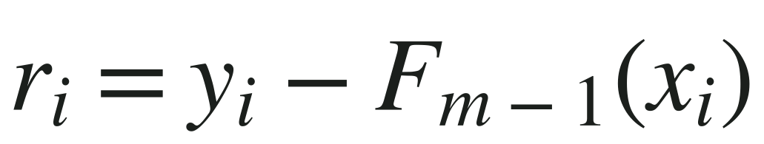
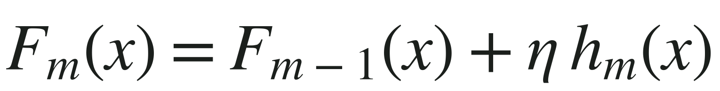
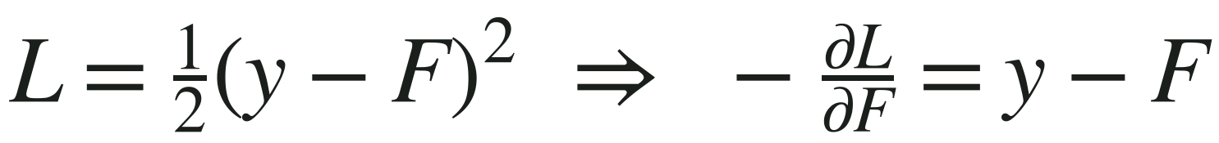
Gradient Boosting Formulas Explained
Residual: actual minus current prediction
Sample 1: 30 − 60 = −30
Update: add the new tree, scaled by learning rate η
F1 = 60 + 0.5 × (−20) = 50
Why "gradient": for squared error, the negative gradient of the loss is the residual
Notes:
Three formulas. Residual: actual minus current prediction (sample 1: 30 - 60 = -30). Update: add the new tree scaled by the learning rate (60 + 0.5 x -20 = 50). Why 'gradient': for squared-error loss, the negative gradient of the loss equals the residual, so fitting residuals is gradient descent.

Slide 31
Gradient Boosting: Worked Example
Sample | Actual y | F0 (mean) | Residual y − F0 | Tree 1 output | F1 = F0 + 0.5 × h | New residual
1 | 30 | 60 | -30 | -20 | 50 | -20
2 | 50 | 60 | -10 | -20 | 50 | 0
3 | 70 | 60 | 10 | 20 | 70 | 0
4 | 90 | 60 | 30 | 20 | 70 | 20
Tree 1 groups the samples and outputs each group's average residual (−20 and +20)
After one tree the biggest error shrinks from 30 to 20
Notes:
Four houses with prices 30, 50, 70, 90. F0 = mean = 60. Residuals = -30, -10, +10, +30. Tree 1 splits them into two groups and outputs each group's average residual: -20 and +20. With learning rate 0.5 the new prediction is F1 = F0 + 0.5 x h1 = 50, 50, 70, 70. New residuals: -20, 0, 0, 20. The biggest error dropped from 30 to 20.

Slide 32
XGBoost: Extreme Gradient Boosting
Gradient boosting, made faster and more accurate
Regularization
Speed
L1 and L2 penalties reduce overfitting
Parallel tree building, built for large data
Missing values
Built-in extras
Learns the best direction for missing data
Tree pruning, cross-validation, early stopping
Notes:
XGBoost = eXtreme Gradient Boosting. Same idea as gradient boosting but engineered for speed and accuracy. Very popular in competitions on tabular data.

Slide 33
XGBoost: The Objective
Loss
how well trees fit the data
+
Regularization
penalty for complex trees
=
Objective
minimise this
γ × number of leaves
λ × (leaf scores)²
Fewer, simpler trees
Smaller, safer leaf values
Also uses gradient and curvature (second order) to pick splits
Notes:
XGBoost minimises Objective = Loss + Regularization. Omega = gamma x (number of leaves) + 1/2 lambda x (sum of squared leaf scores). XGBoost also uses second-order information (the curvature of the loss) when scoring splits.

Slide 34
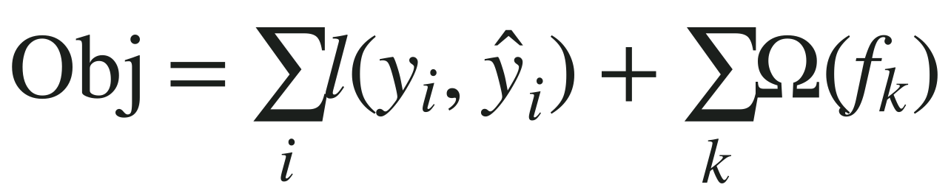
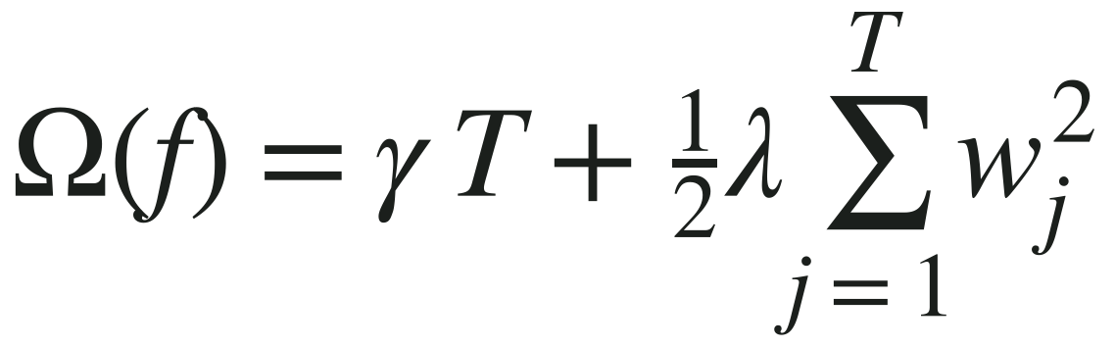
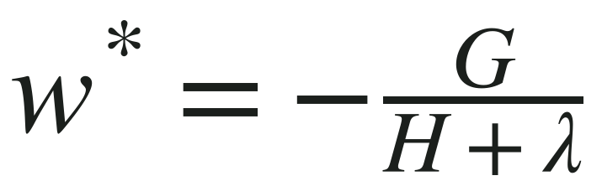
XGBoost Formulas Explained
Objective: loss over all samples + penalty for every tree
l = loss, ŷ = prediction
Penalty: T = number of leaves, w_j = leaf scores
γ punishes leaves, λ punishes big scores
Leaf score: G = sum of gradients, H = sum of second derivatives
Residuals −30, −10: G = 40, H = 2
λ = 0 → w = −20; λ = 2 → w = −10
Notes:
Objective = total loss over all samples plus a penalty for every tree. Omega: gamma times the number of leaves T plus half lambda times the sum of squared leaf scores. Best leaf score w* = -G/(H+lambda) where G is the sum of gradients and H the sum of second derivatives in the leaf. Example: residuals -30 and -10 give G = 40, H = 2; lambda 0 gives -20, lambda 2 gives -10.

Slide 35
XGBoost: Missing Values and Speed
Learned default direction
Missing values follow a learned default direction
Split search runs across columns in parallel
Sorted data blocks are reused to save time
Sparse data is handled efficiently
Chest Pain?
Yes
No
Left
Right
default
Missing
Notes:
Sparsity-aware split finding: for every split, XGBoost tries sending the missing values left and right and keeps the direction that reduces the loss most. That becomes the default direction at that node. Speed comes from searching split candidates across columns in parallel and storing data in sorted blocks.

Slide 36
XGBoost: Key Settings
Setting | What it controls
n_estimators | Number of trees
learning_rate | Step size per tree (small = safer)
max_depth | How deep each tree can grow
subsample | Fraction of rows used per tree
colsample_bytree | Fraction of columns used per tree
reg_lambda | L2 penalty on leaf scores
Notes:
Main XGBoost knobs. Typical recipe: small learning_rate, more trees, shallow max_depth (3 to 6), subsample and colsample_bytree below 1, and tune reg_lambda.

Slide 37
Try It in Python
from sklearn.ensemble import (
AdaBoostClassifier,
GradientBoostingClassifier)
from xgboost import XGBClassifier
ada = AdaBoostClassifier(n_estimators=100)
gb = GradientBoostingClassifier()
xgb = XGBClassifier(n_estimators=300)
for m in (ada, gb, xgb):
m.fit(X_tr, y_tr)
print(m.score(X_te, y_te))
Notes:
Live demo idea: run this on the breast cancer dataset from scikit-learn, compare the three scores, then vary n_estimators and learning_rate. Requires pip install xgboost.

Slide 38
AdaBoost vs Gradient Boosting vs XGBoost
 | AdaBoost | Gradient Boosting | XGBoost
Fixes errors by | Re-weighting examples | Fitting residuals | Fitting residuals (optimized)
Base learner | Decision stumps | Small decision trees | Small decision trees
Overfitting control | Limit the rounds | Learning rate | Regularization + learning rate
Speed | Moderate | Moderate | Fast (parallel)
Notes:
Summarise the three boosting algorithms. AdaBoost re-weights examples; gradient boosting fits residuals; XGBoost is an optimised, regularised version of gradient boosting.

Slide 39
Bagging vs Boosting
 | Bagging | Boosting
Training | Parallel, independent | Sequential, dependent
Main goal | Reduce variance | Reduce bias
Data focus | Random bootstrap samples | Hard (misclassified) examples
Combining | Equal vote or average | Weighted vote
Overfitting | Low risk | Higher on noisy data
Example | Random Forest | AdaBoost, XGBoost
Notes:
Use this slide to summarise. Ask: which would you try first if your model is underfitting? (Boosting.) Overfitting? (Bagging.)

Slide 40
Stacking
Decision Tree
Meta-model
Final prediction
SVM
Neural Net
Base models
Mixes different types of models
Meta-model learns how to best combine their predictions
Notes:
Stacking: train different kinds of models, then train a meta-model whose inputs are the base models' predictions. It learns who to trust.

Slide 41
Quick Check
Why does bagging help deep trees more than linear models?
1
Why can boosting overfit noisy data?
2
Your model underfits. Bagging or boosting first?
3
Notes:
Give students a minute in pairs, then take answers. 1) Deep trees are unstable (high variance) so averaging helps a lot. 2) Boosting keeps increasing weights on mislabeled points and chases noise. 3) Boosting, since it reduces bias.

Slide 42
Key Takeaways
Ensemble = many models combined into one stronger model
Bagging: parallel models on bootstrap samples, reduces variance
Random Forest: bagging + random columns at each split
Boosting: sequential models that fix earlier mistakes (AdaBoost, Gradient Boosting, XGBoost)
Stacking: a meta-model learns to combine different models
Notes:
Close with the two-sentence summary: bagging averages many independent models to cut variance; boosting builds models in sequence to cut bias.

